Slide 1

Shell Bootcamp 2024 3 Reflections for Week 2
Aayush Dhondiyal
Date : 06-Sep-2024

Slide 2

About Me
Stop Complaining, Start Working!
A phrase that represents
my motto in life

Slide 3

My learnings from this week!

Slide 4
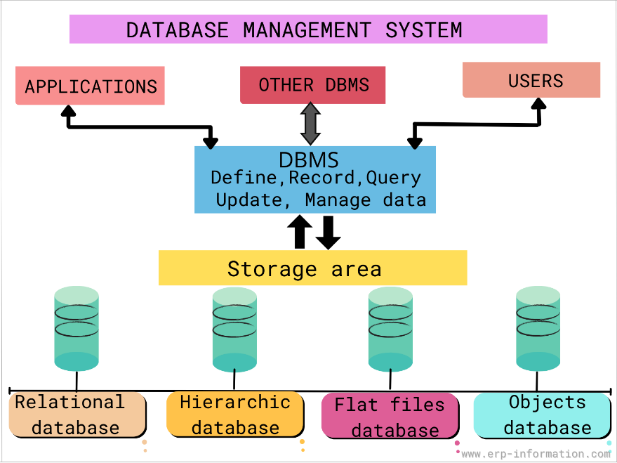
Learning 1 | My takeaways
Key learning
DBMS allows for efficient storage, retrieval, and management of data in a structured format.
Key takeaway
Ensures data reliability and integrity through ACID properties (Atomicity, Consistency, Isolation, Durability).
How do I personally see this concept implemented in the Energy sector
In the energy sector, DBMS plays a crucial role in managing vast amounts of data generated from various sources like smart meters, sensors, and energy management systems.

Slide 5

Learning 2 | My takeaways
Key learning
Cloud provides scalable, flexible, and cost-effective IT infrastructure.
Key takeaway
It reduces operational costs, enhances agility, and supports innovation.
How do I personally see this concept implemented in the Energy sector
Enables remote monitoring, management, and predictive maintenance.

Slide 6
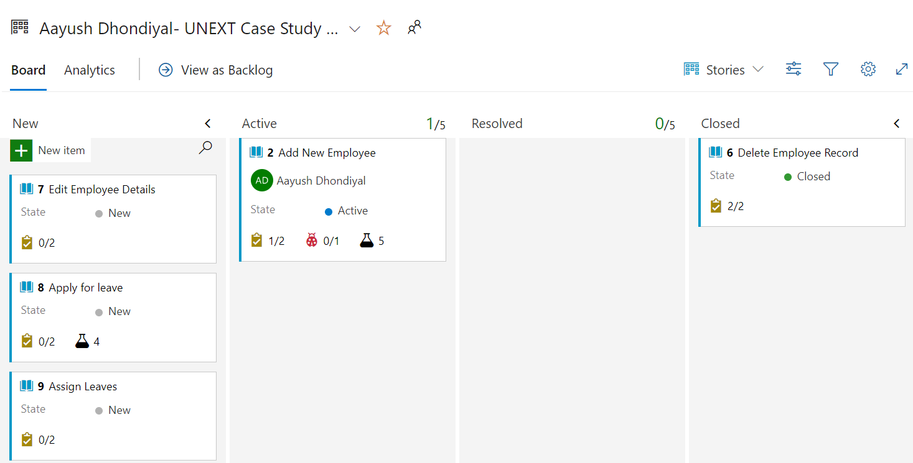
Learning 3 | My takeaways
Key learning
Dev Ops streamlines software development, testing, and deployment processes.
Key Takeaway: Implementation in Energy Sector.Key takeaway
Enhances collaboration, productivity, and software quality.
How do I personally see this concept implemented in the Energy sector?
It automates workflows, improves project management, and accelerates innovation.

Slide 7

Relevance of learnings for my organization

Slide 8
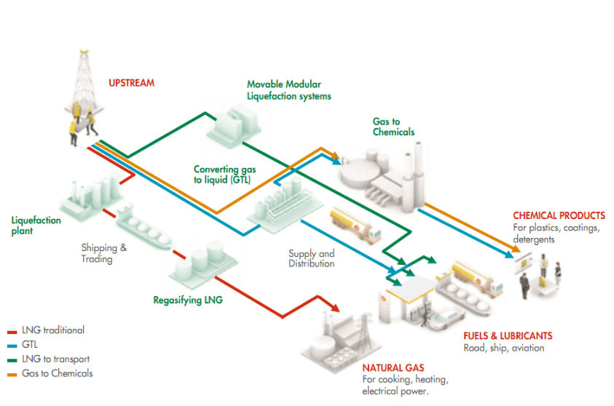
Learning 1 | Relevance for Shell
How I feel Shell implements this learning
- Shell uses DBMS to manage its extensive data related to exploration, production, and distribution of energy.
How I feel Shell benefits from this learning
-Operational Efficiency: Improved data management leads to more efficient operations.
Cost Reduction: Advanced analytics help in identifying cost-saving opportunities.
Enhanced Security: Robust security measures protect sensitive data.

Slide 9
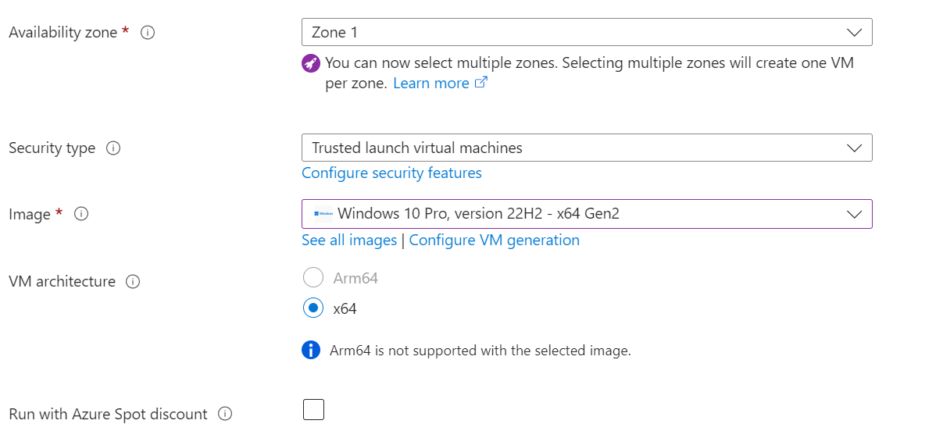
Learning 2 | Relevance for Shell
How I feel Shell implements this learning?
- Shell facilitates global collaboration, innovation, and faster deployment of new technologies and services and this enhances the overall productivity.
How I feel Shell benefits from this learning?
- Shell adopts hybrid cloud solutions to balance flexibility, control, and cost-effectiveness, ensuring optimal performance.

Slide 10
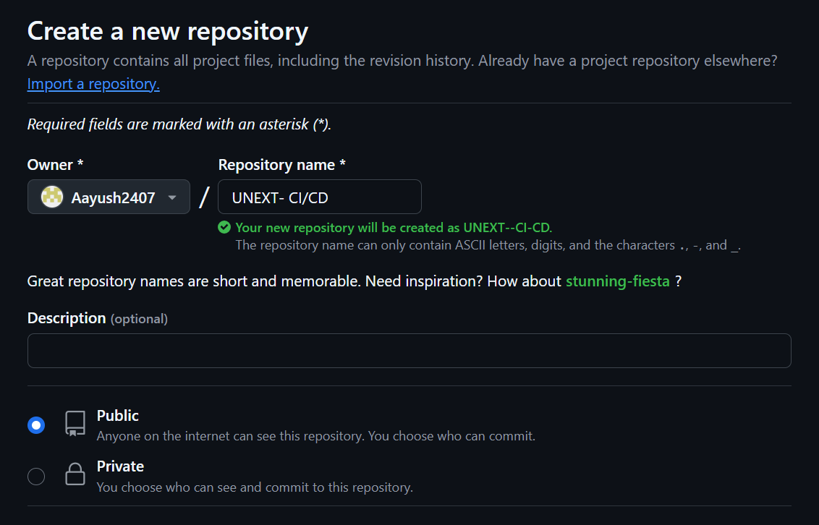
Learning 3 | Relevance for Shell
How I feel Shell implements this learning?
-Shell accelerates digital transformation, improves operational efficiency, and reduces time-to-market for new applications and services.
How I feel Shell benefits from this learning?
- Shell uses CI/CD pipelines for continuous delivery, integration, and automated testing of software solutions, ensuring high quality.

Slide 11

Challenges in implementing learning

Slide 12

Challenge faced while implementing Learning 1
What were the challenges I faced while implementing Learning 1 and my plan to overcome them?
DBMS plays a crucial role in any organization and there might be few difficulties in some complex equations. Ensuring data security against cyber threats is a major challenge.
Taking the help of experienced personnel will not harm anyone as any data loss or breach will be harmful.

Slide 13
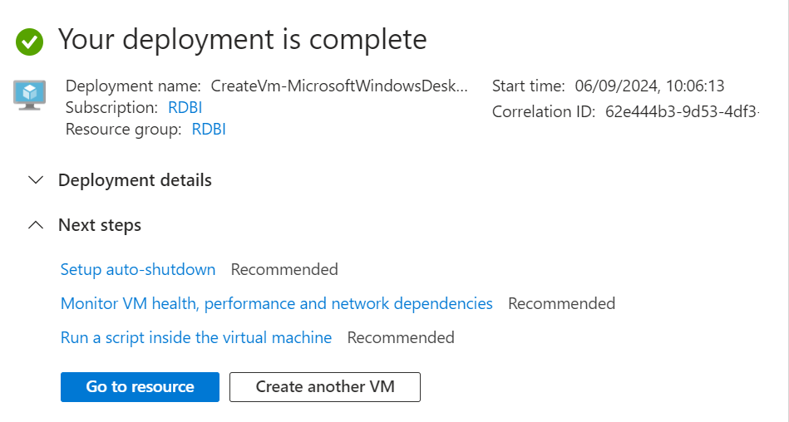
Challenge faced while implementing Learning 2
What were the challenges I faced while implementing Learning 2 and my plan to overcome them?
- Setting up Virtual Machines was a novel task in the beginning but after 2-3 iterations, there is some sense of understanding regarding the field.

Slide 14
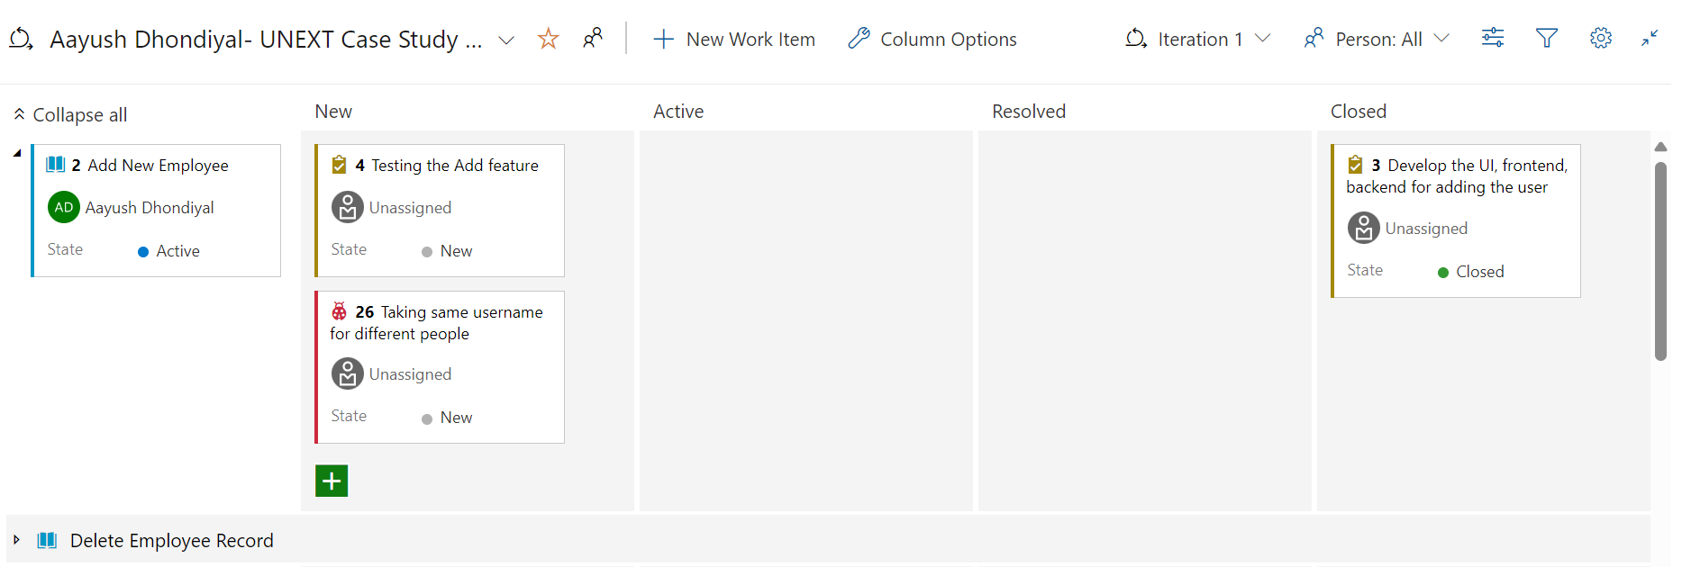
Challenge faced while implementing Learning 3
What were the challenges I faced while implementing Learning 3 and my plan to overcome them?
Azure Dev Ops was a new experience as well. Understanding via theory was slightly complex but with more hands-on experience, I understood all the necessary components of the workstation.
https://github.com/Aayush2407/Unext-Learning

Slide 15

Action Plan

Slide 16
My Action Plan for this Week
Actions
Timeline
Status
Study stakeholder management strategies and tools.
Practice creating test cases and scenarios for a sample project.
Perform a mock testing session, documenting findings and improvements.
Explore infrastructure as code (IaC) concepts.
Integrate the pipeline with your DBMS.
Learn about pull requests and code reviews.
Automate deployment processes using shell scripts.
Review security measures and optimize the deployment process.
Day 1- Business Analysis
Day 2- Software Testing
Day 3- DBMS
Day 4- Cloud Computing/ Github
Day 5- Case Study
All tasks completed.
Azure Dev Ops, Github understood.

Slide 17

Learning is also Fun!

Slide 18
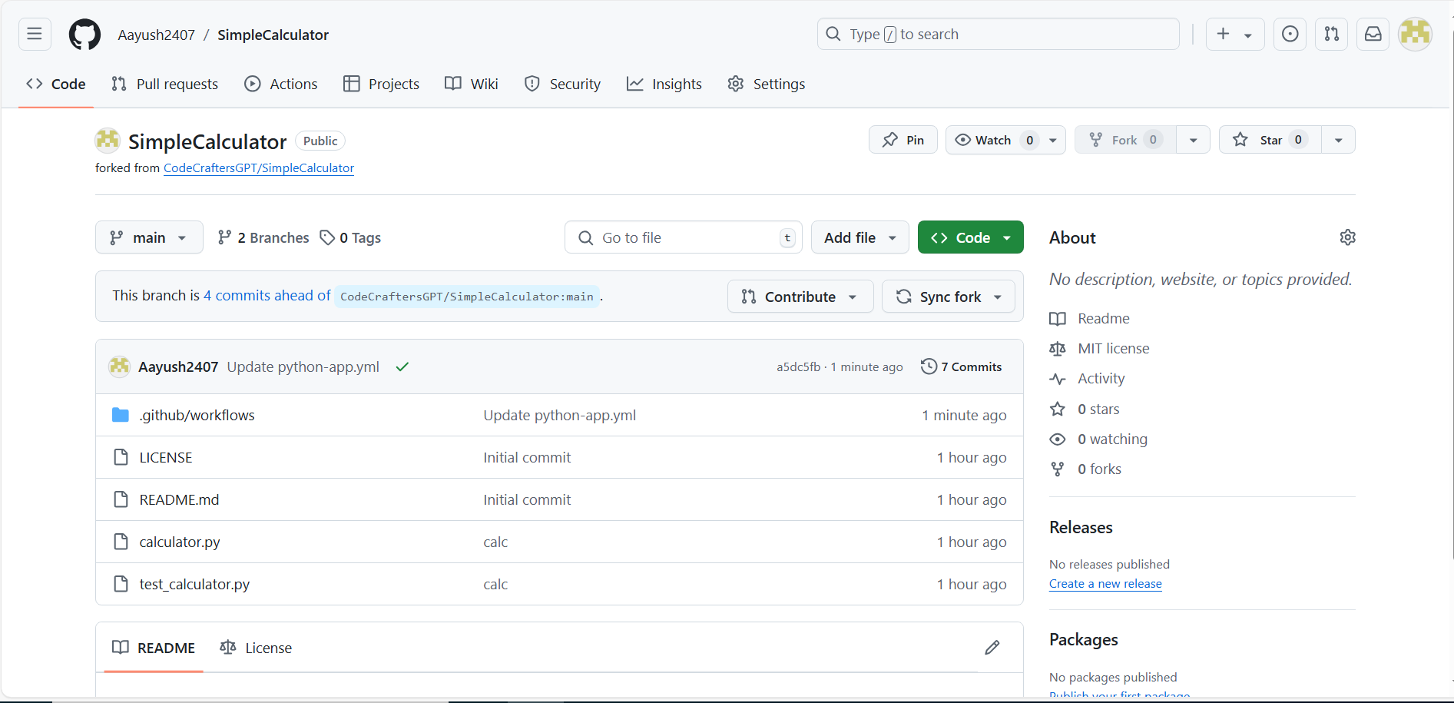
Learning is also Fun!
Details of any group activity
The Case Study involved all the critical technical concepts that would be needed as an IT professional including Git, Azure Dev Ops, Virtual machines.
https://github.com/Aayush2407/SimpleCalculator

Slide 19

Summary
Quick summary
This week’s tasks were focused on business analysis and software testing to begin with. The focus was then shifted to DBMS, cloud computing, Azure dev ops and github. The last day of the journey utilized a case study which involved all the technicalities coming into play for a comprehensive assessment.

Slide 20
Thank You

